Slide 1
ECP Support Enhancements for R4

Slide 2
Enhancements
Case Management
Trouble ticket consolidation: Trouble tickets moved to case, one flow for getting help
Users can manage and update their cases and trouble tickets directly from the case history or case detail pages.
Orders & Tickets – Changed to just orders for clarity
Case Submission - Select a Product or Service Category dropdown now grouped into sections
Case History table – Improvements to findability
Now populates category for all case types (was often blank or generic in old stack)
Has combined Product & Type filter into a category filter for simplification
Subject line - No longer generic on ticket view, sharing actual subject line from SFDC
Case details tab - Has enhanced formatting, and limited concatenation
Contacts - Ability to see all contacts associated to a case (including unregistered)
Case classification enhancements - Consistency across options, improved case types (link to doc)

Slide 3
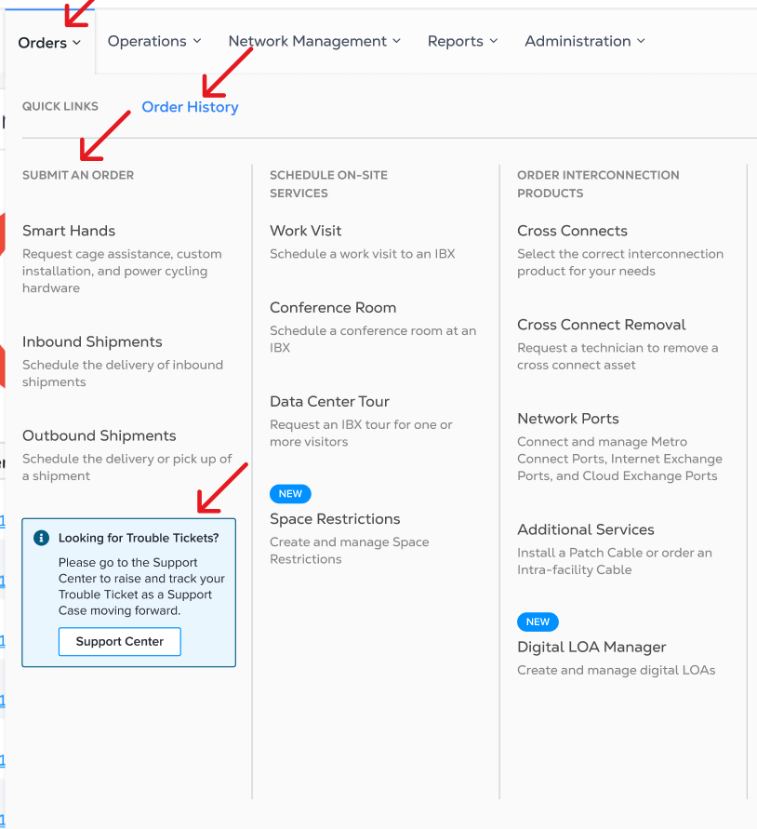
Trouble tickets are now just Support cases
Reduced complexity : Customer no longer needs to distinguish between a "Support Case" and a "Trouble Ticket". Users can view and manage all their tickets from case history and details page.
One flow for raising a case including trouble tickets
Trouble tickets are now simply referred to as cases
Extensive Appque messaging will be in place for LTC customers to explain changes
See full Figma walkthrough here
Measuring success: New stack CSAT submission should beat old stack CSAT for trouble tickets by 5% 90 days post migration
Stack | CSAT - Case submission
Old stack | 79%
New stack (LTC) | 83% (Target)

Slide 4
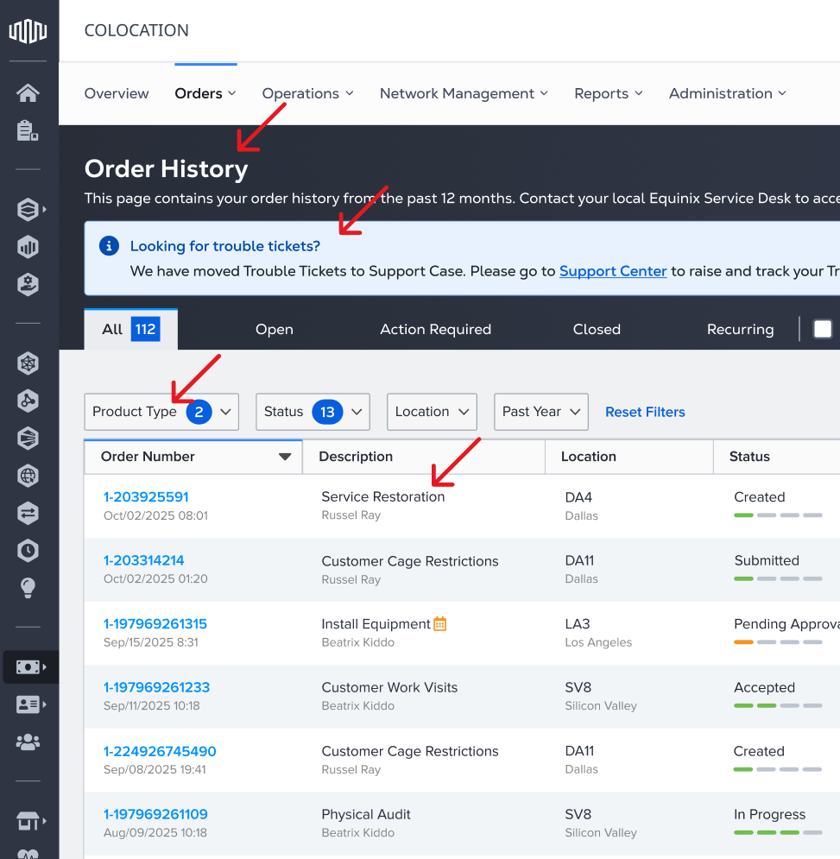
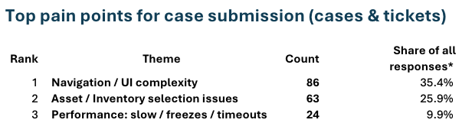
Orders & Tickets changed to just orders for clarity
Cases terminology consolidated on Support center: In line with the trouble ticket changes the "Order & ticket history" page will be simplified to just "Orders"
See full Figma walkthrough here
Measuring success:
This is a small incremental change.
Will look for decrease in Navigation / UI Complexity feedback from LTC customers. Currently 35% of CSAT case submission responses mention this.

Slide 5
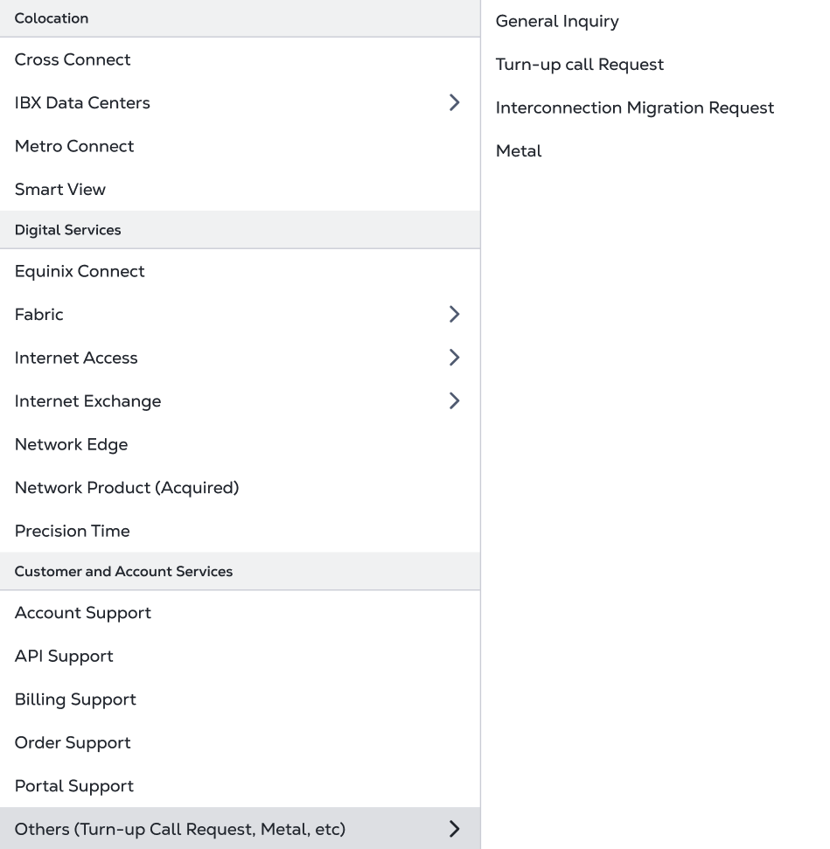
Select a Product or Service Category dropdown now grouped into sections
Additional sections in dropdown for easier navigation: Instead of one big list to navigate the dropdown for ticket creation will now be broken out into more logical sections.
This change will also apply to non-LTC customers
See full Figma walkthrough here
​
Measuring success:​
This is a small incremental change. ​
Will look for decrease in Navigation / UI Complexity feedback from LTC customers. Currently 35% of CSAT case submission responses mention this theme.​
​
​

Slide 6
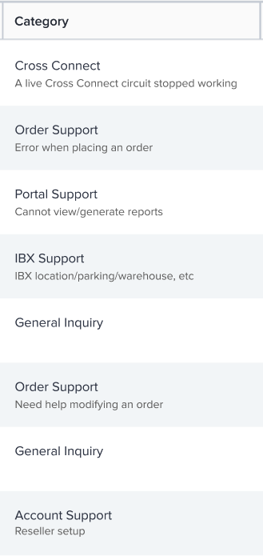
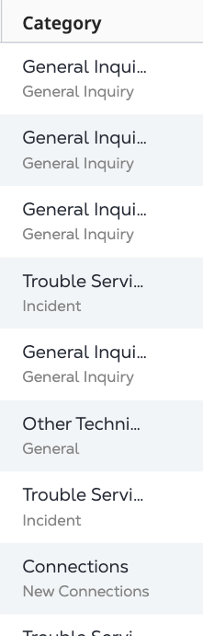
More readable category for Support Case History table
New stack
Old stack
Case history table consistently populates a category: For LTC customers only category will accurately reflect the nature of the case
See full Figma walkthrough here
See mapping logic here
Measuring success:
Only 19.9% of customers select a support case on the support case when navigating to Support Case History page. With more readable table, we expect to see a 10% increase in customers selecting a support case
Stack | Select support case
Old stack | 20%
New stack (LTC) | 22% (target)
Note for R4 customers will see high level category (not subcategory / supporting text underneath)

Slide 7
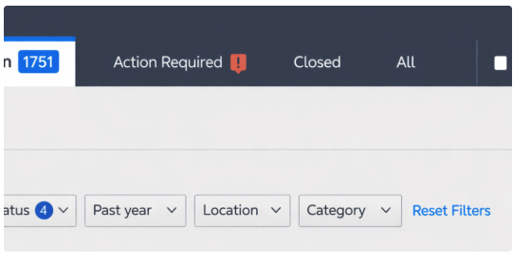
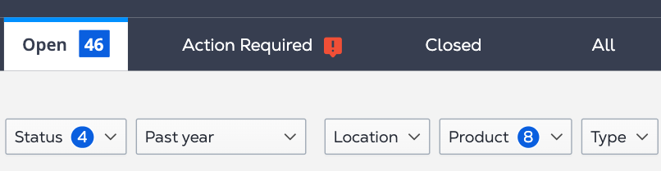
Filter simplification
New stack
Old stack had two competing filters that customers would need to switch between to sort their cases. This has been simplified so that users just have one category filter to sort on.
For ease of use, category filter is a 1:1 match to the category selections we provided to customers on case creation
See mapping logic here
Measuring success:
A 5% improvement on percentage of customers who select a support case after interacting with our filters (looking into how this is tracked today for baseline)
Old stack
Stack | Select support case
Old stack | 35%
New stack (LTC) | 37% (target)

Slide 8
Subject line provides details on case(no longer generic)
In the old stack subject lines were generic and missing key details, making it hard to understand what the case was about. See mapping logic here
For case submitted in portal subject line will contain [Product category] + [Product Sub-Category] + [Specific Case Type]
For case submitted outside the portal ECP will use the SFDC subject line
What subject line looks like for a case submitted for IBX environment > water leak:
Old stack
New stack
Measuring success:​​
This is a small incremental change. ​​Will look for decrease in Navigation / UI Complexity feedback from LTC customers. Currently 35% of CSAT case submission responses mention this theme.​​
More examples from new stack
Fabric – Ports: Provisioning & Deprovisioning
Precision Time – Services: Configuration Change
Colocation – Remote Hands: Installation Assistance

Slide 9
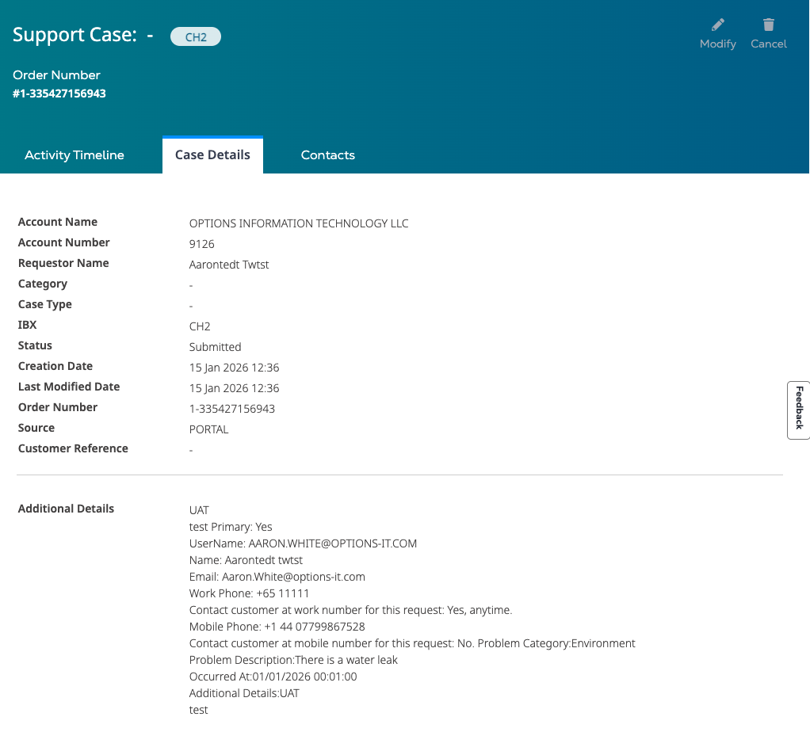
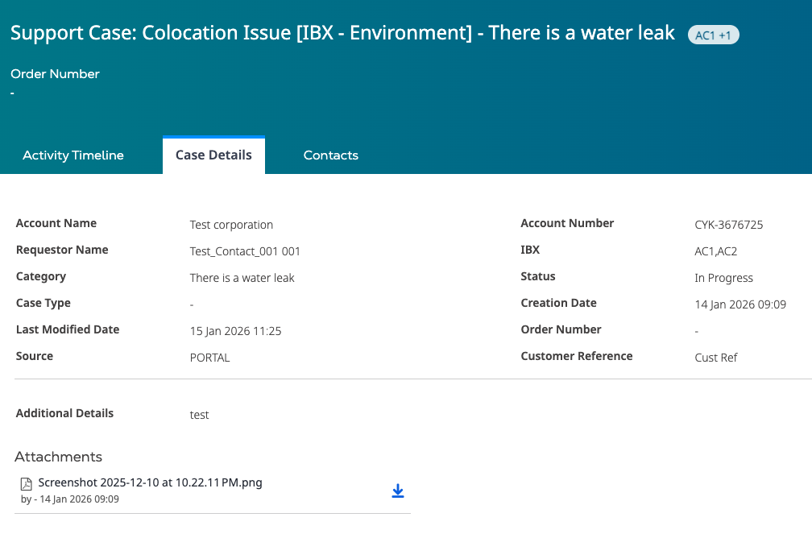
More case details mapped to fields vs concatenated
In the old stack the case details tab had much of the key information concatenated. In the new stack there are more fields that are mapped, to making the information easier to digest
Old stack
Fields concatenated, hard to read through
Measuring success:​​
This is a small incremental change. ​​Will look for decrease in Navigation / UI Complexity feedback from LTC customers. Currently 35% of CSAT case submission responses mention this theme.​​
New stack
Mapped to fields and easier to read

Slide 10
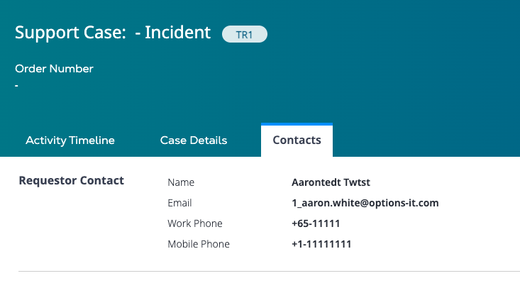
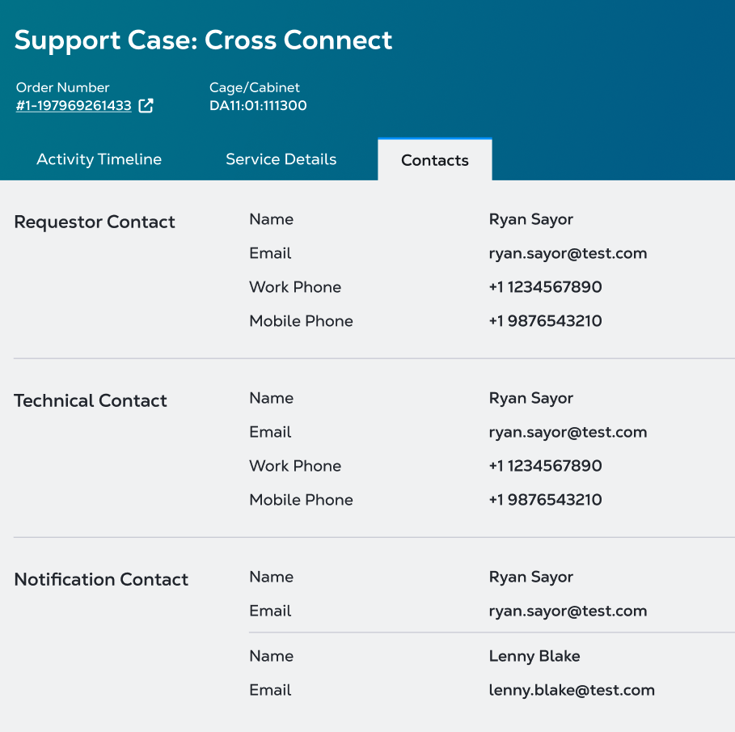
Ability to see all contacts associated to a case (including unregistered)
Previously you could only see requester contacts, now you can see unregistered and technical contacts associated to case as well
Old stack
Can only view requester contact
Measuring success:​​
This is a small incremental change. ​​Will look for decrease in Navigation / UI Complexity feedback from LTC customers. Currently 35% of CSAT case submission responses mention this theme.​​
New stack
All contact types shown

Slide 11
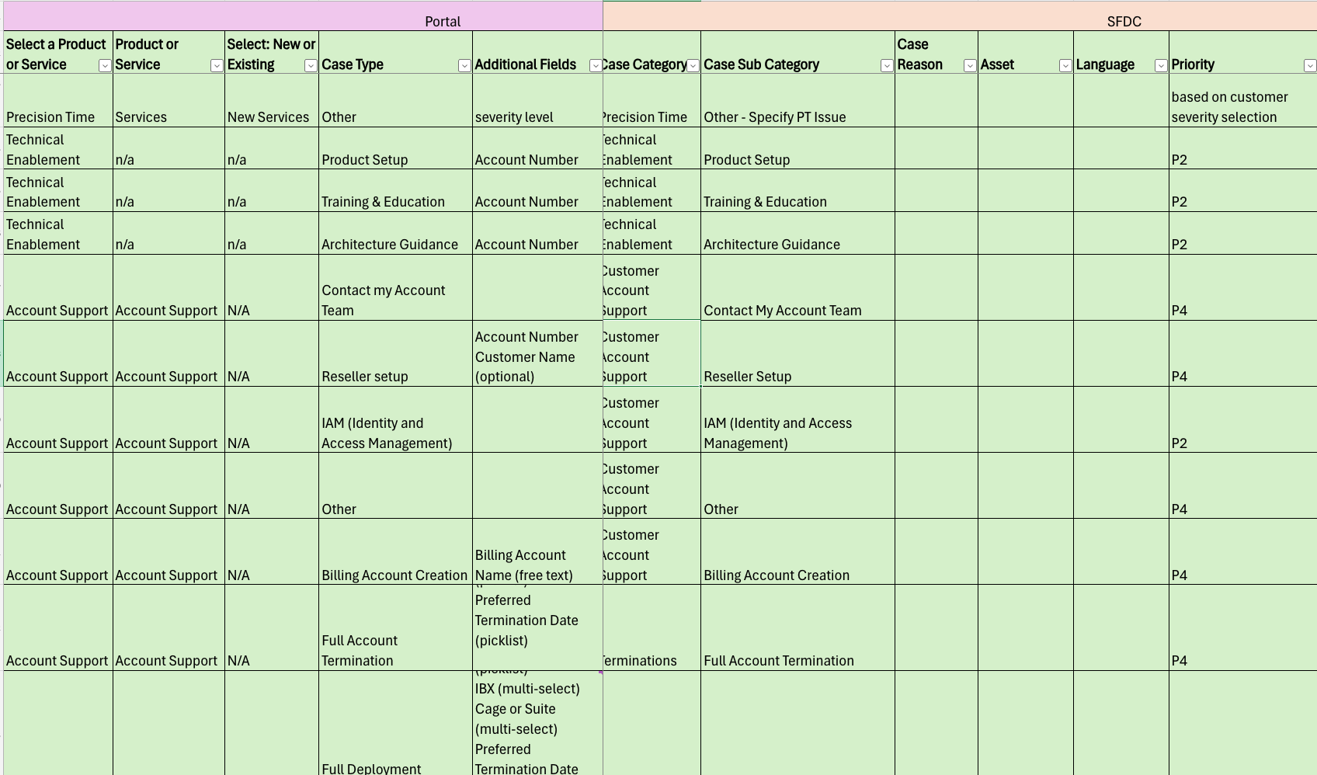
Case Classification Enhancements
The case types that customers can select when creating a ticket are more intuitive and consistent across our product offerings, the subsequent mapping to SFDC has also been improved.
Case types are now a reflection of what the customer needs help with, not the severity of issue
More consistent case types across Equinix products
See mapping sheet here
MVP Master Case Sheet.xlsx

Slide 12
Measuring success
Outline here how we will do this
Also chat to Nicole to do a survey / interview to get to a baseline. 10-15 super users to work with that can show us before and after
Additional survey for LTC migrated customers on case submission with check on willing to talk to us about their experience

Slide 13
One pager
High level summary of changes along with appendix and deck can be the reference for this.

